Slide 1
Seattle Data AI Security Hackathon Team 4

Slide 2
Members
Megha Narendra Simha
Neha Arora
Pratham Balaji
Eshwar

Slide 3
Agenda
Introduction
Building confidence
Engaging the audience
Visual aids
Final tips & takeaways

Slide 4


Slide 5
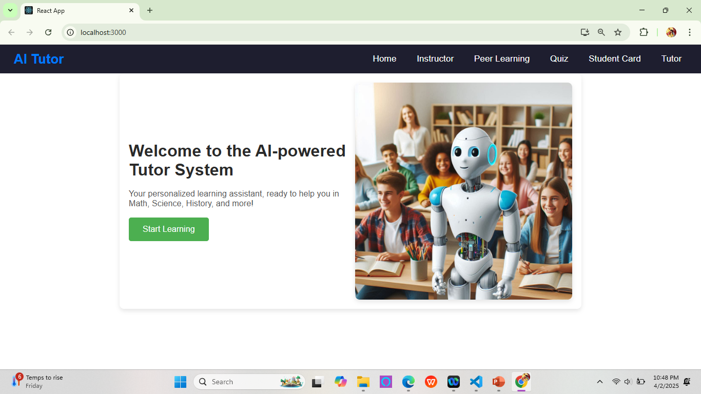
Home Page

Slide 6
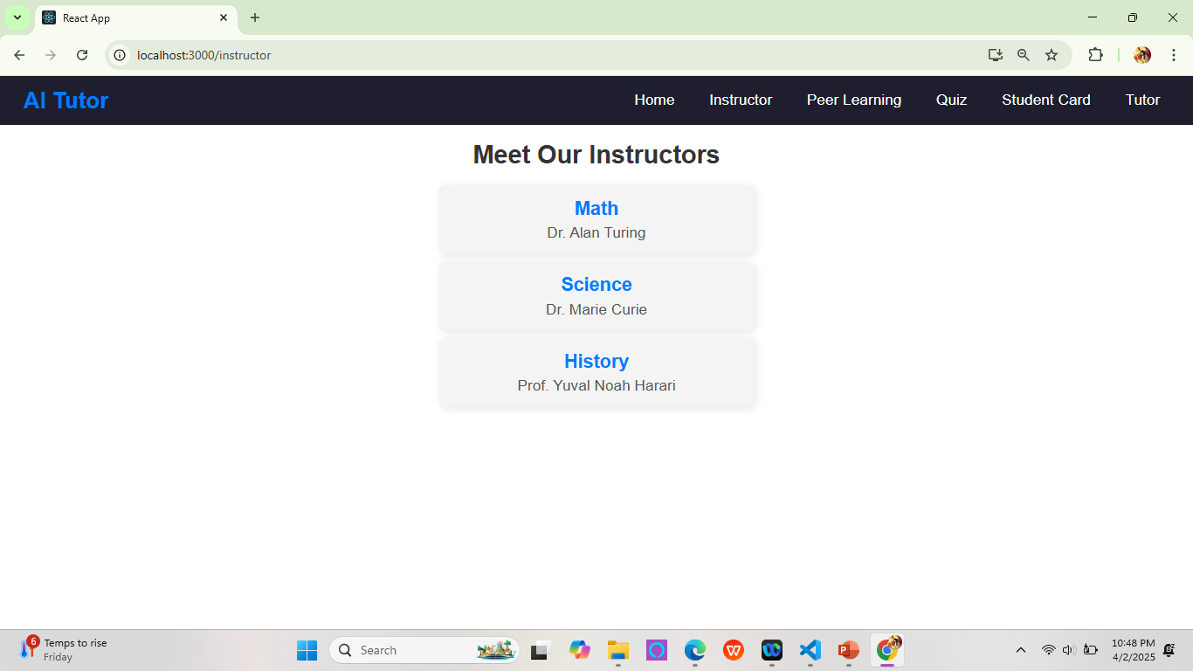
Instructor

Slide 7
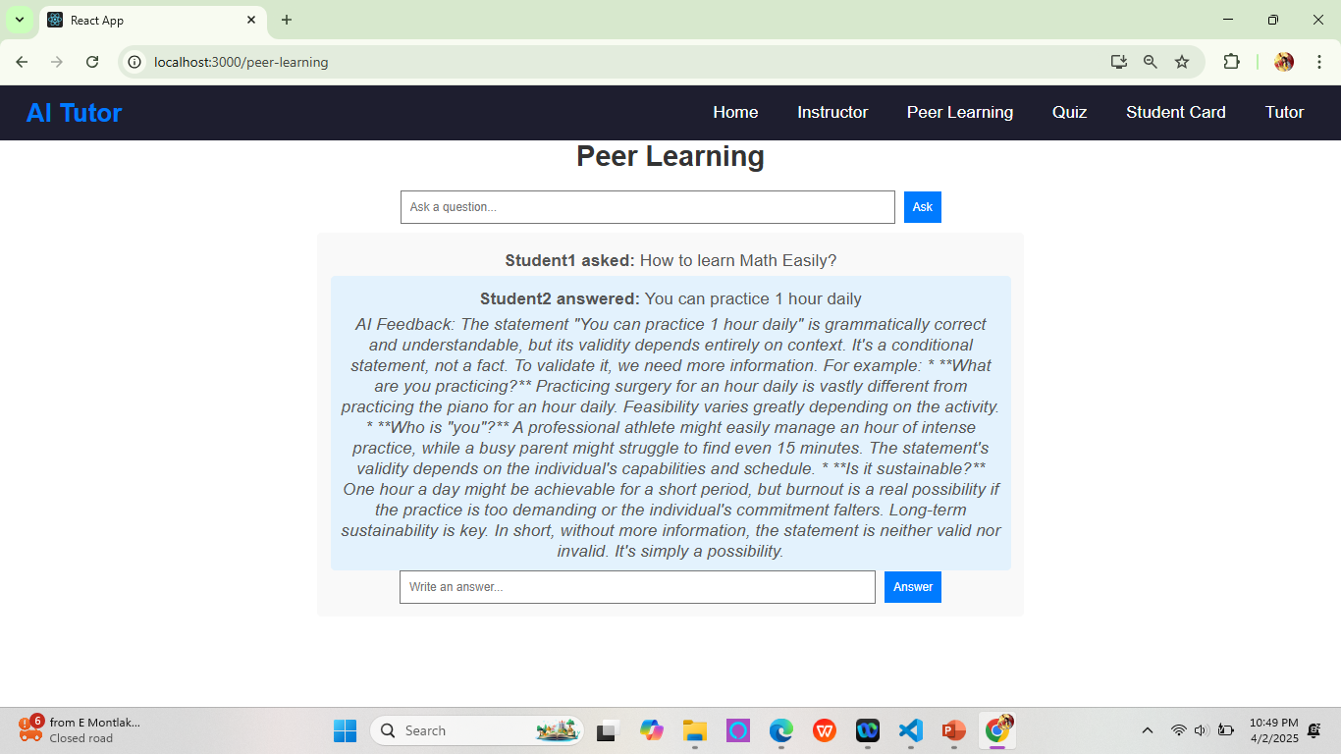
Peer Learning

Slide 8
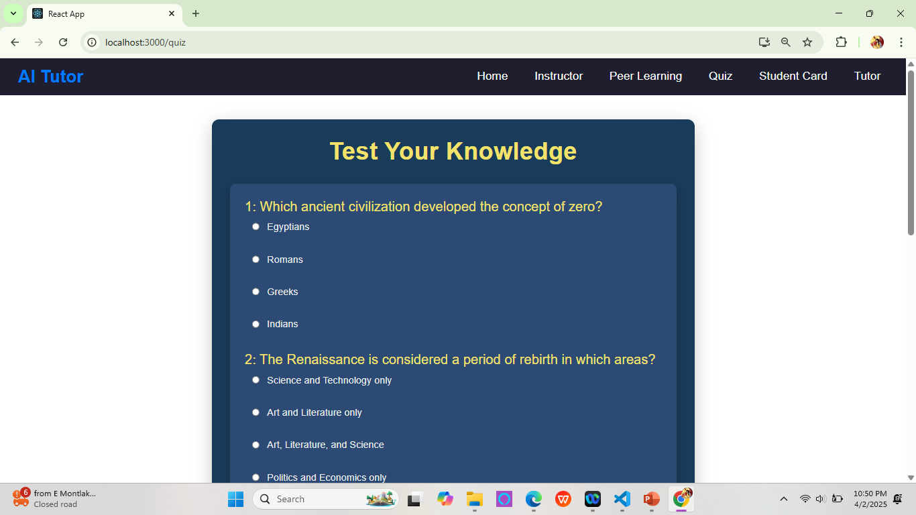
Quiz

Slide 9
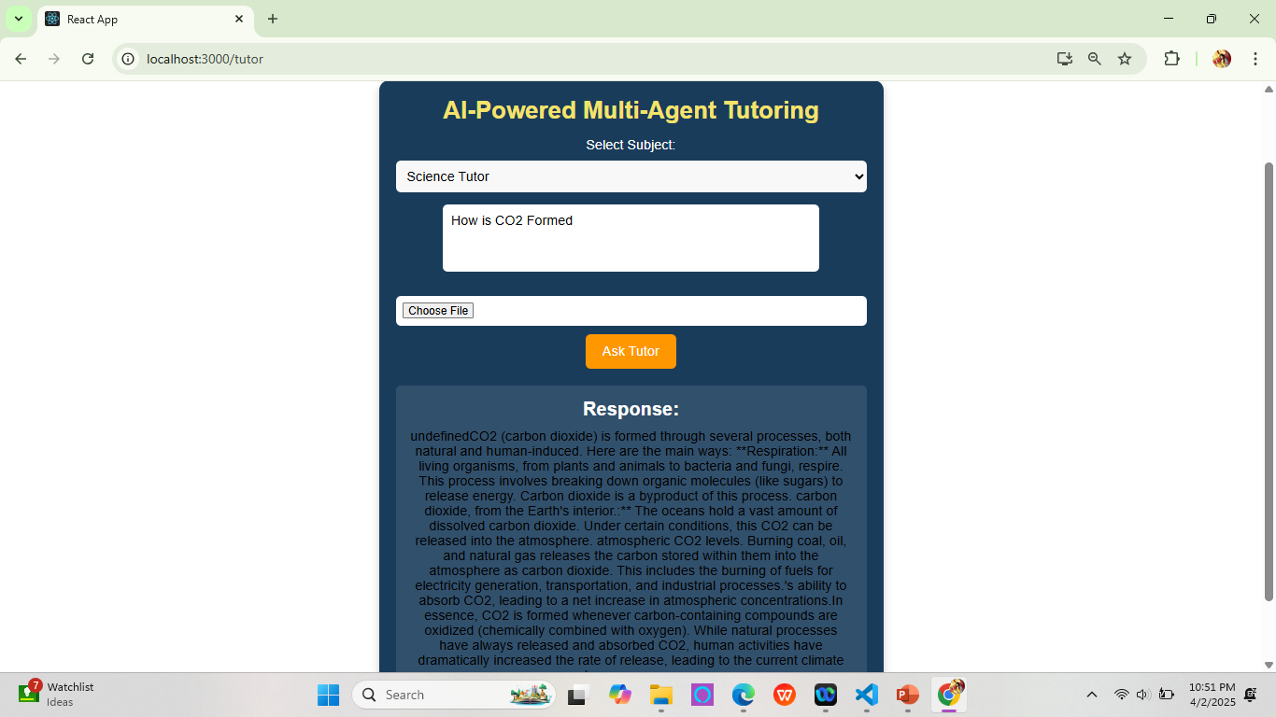
AI Tutor

Slide 10
Navigating Q&A sessions

Slide 11

Speaking impact

Slide 12
Final tips & takeaways
Consistent rehearsal
Strengthen your familiarity
Refine delivery style
Pacing, tone, and emphasis
Timing and transitions
Aim for seamless, professional delivery
Practice audience
Enlist colleagues to listen & provide feedback
Seek feedback
Reflect on performance
Explore new techniques
Set personal goals
Iterate and adapt

Slide 13
Thank you
Team 4

